Slide 1

Reactive Kinesis + Spring

Slide 2
Agenda
Introduction
Spring, Kinesis, Reactor and code, lots of code…
Questions

Slide 3

Some Introduction

Slide 4


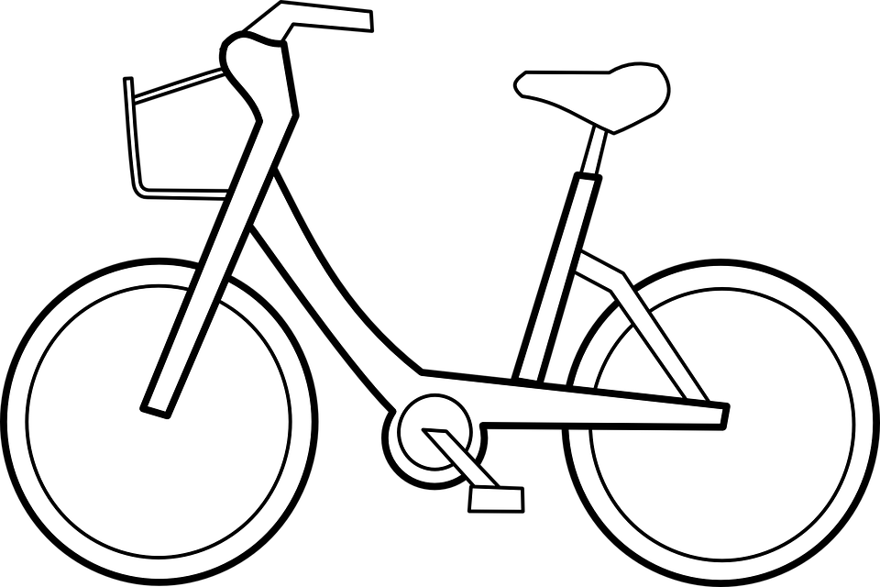
Who are we and what do we do?
Tech Company
Based in Amsterdam
35 engineers (and growing)
11 AWS accounts (and growing)
100s of clients (and growing)
100s of ec2 instances (and growing)
15 microservices (and growing)
30k events per second (and growing)

Slide 5

Growth Challenges

Slide 6
Growth Challenges
Many teams, many apps
Monitoring
Multitenancy
Various messaging payloads: Fast vs Slow

Slide 7

And even more...
ActiveMQ (non-reactive) codebase based on Spring JMS
5000+ unit and integration tests, 1000s of AMQ related tests
15 microservices and 5 teams constantly releasing
Java Serialization

Slide 8

The Plan

Slide 9

Step 1. (Java Serialization has to go)

Slide 10
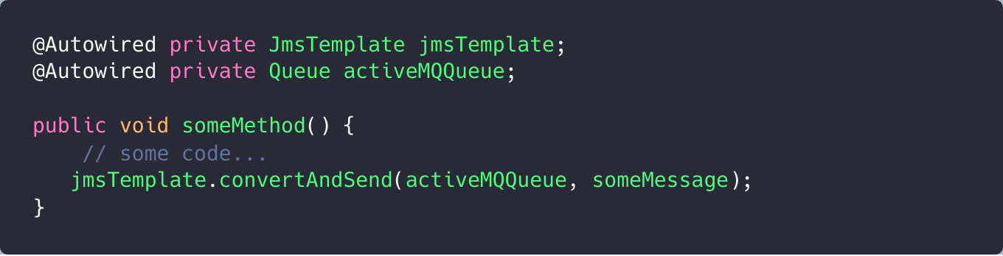
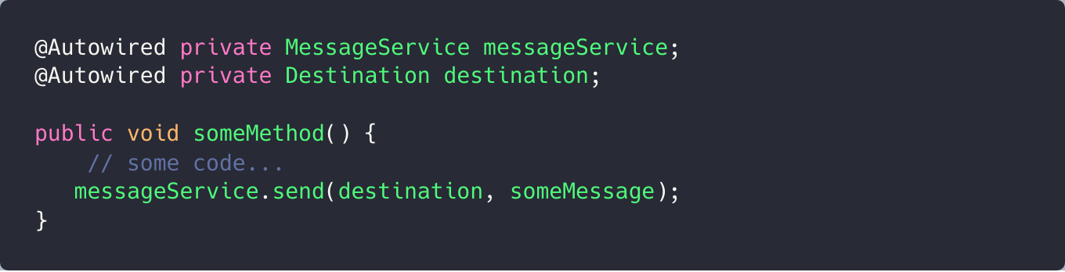
Step 2. (Build a Library)
Sending
VS

Slide 11
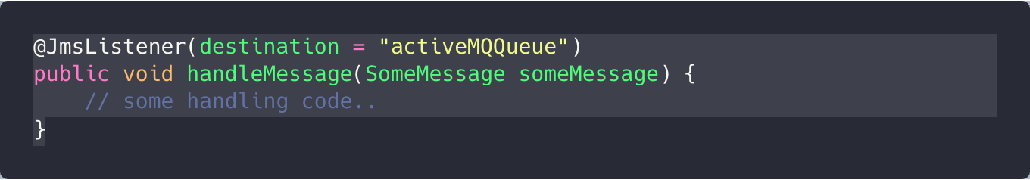
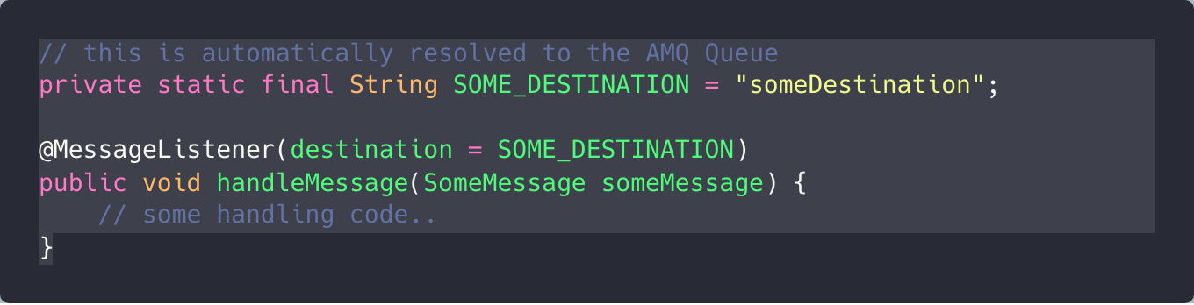
Step 2. (Build a Library)
Consuming
VS

Slide 12
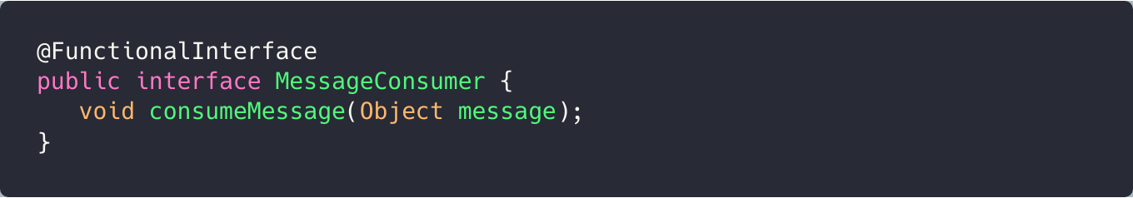
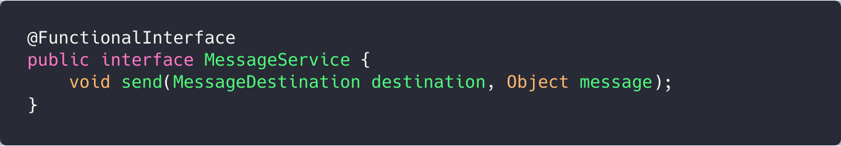
Step 2. (Build a Library)

Slide 13
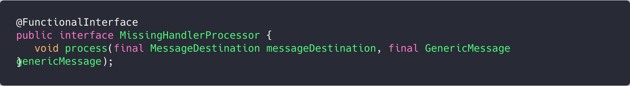
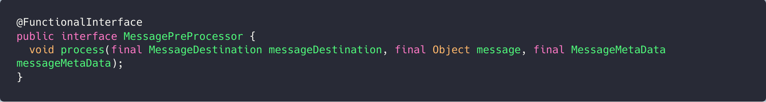
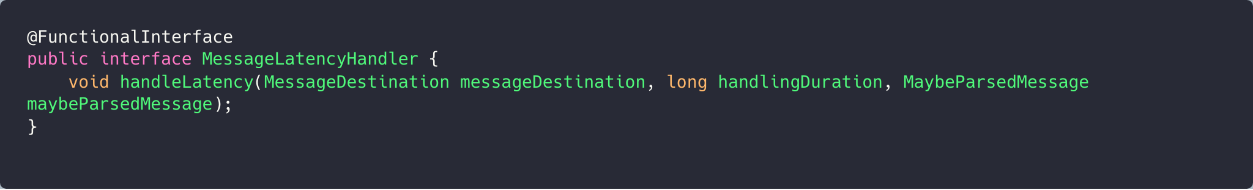
Step 2. (Build a library) The defaults

Slide 14
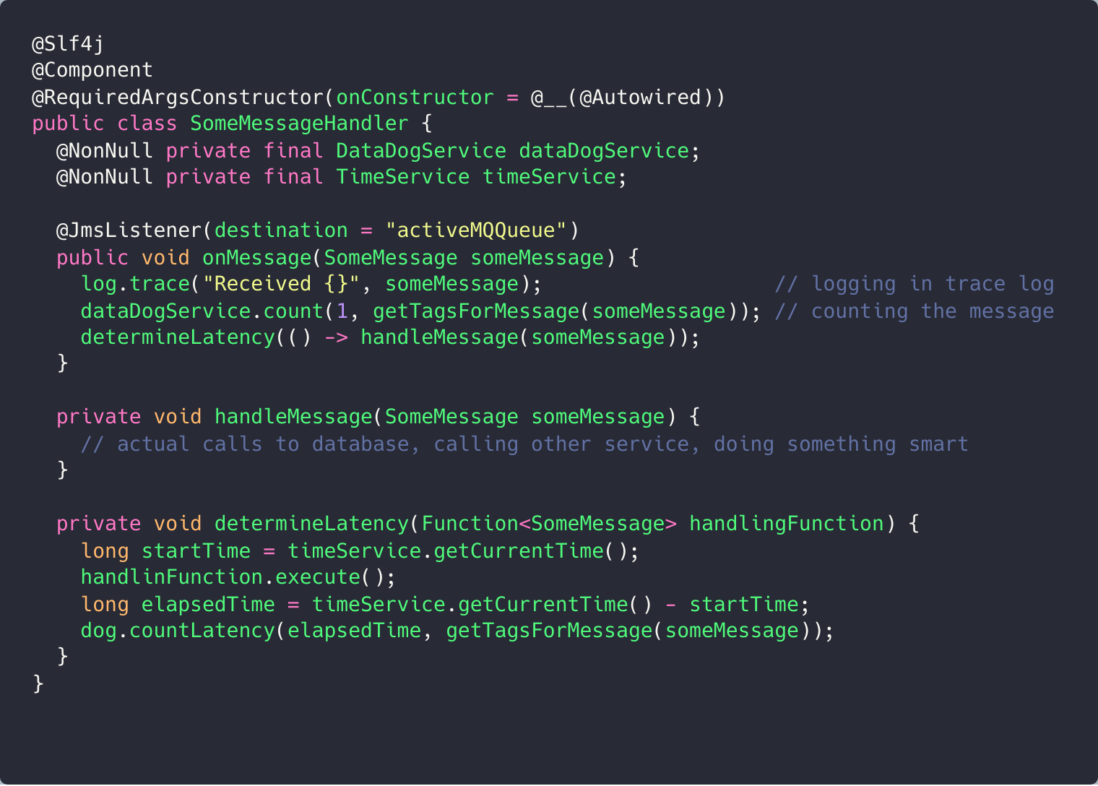
Why?!

Slide 15
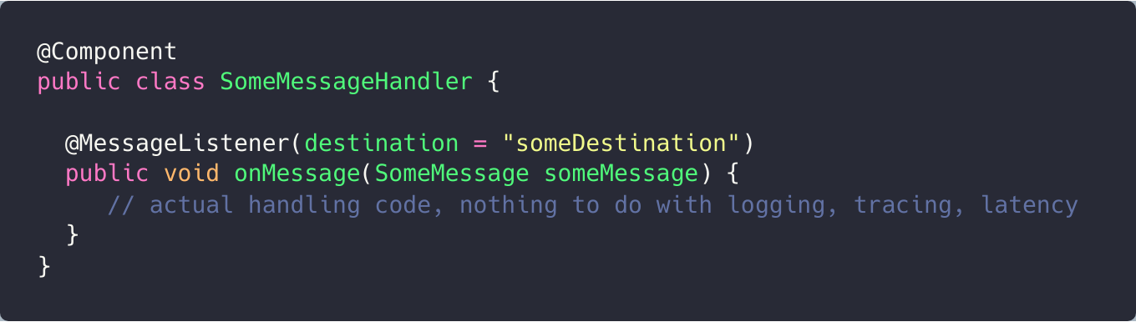
Why?!

Slide 16
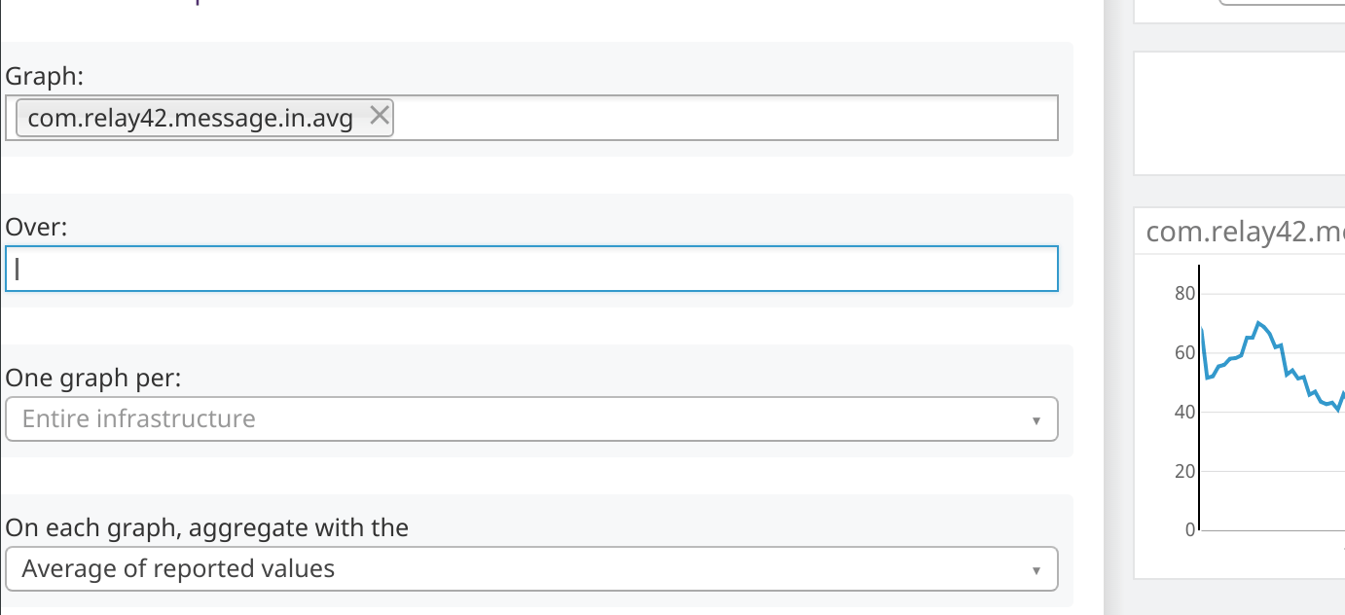
Why?!
Monitoring
Multitenancy
Logging

Slide 17
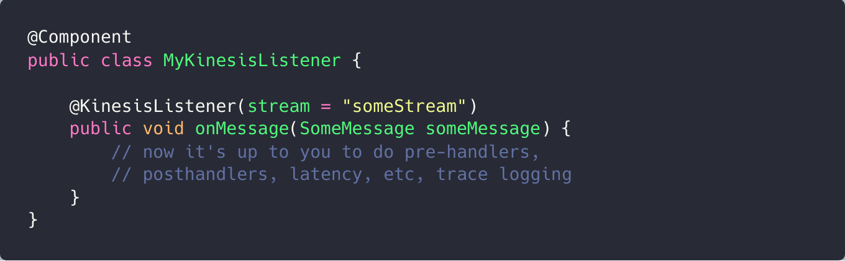
Step 3. Kinesis
Taking a look at Spring Cloud Kinesis:

Slide 18
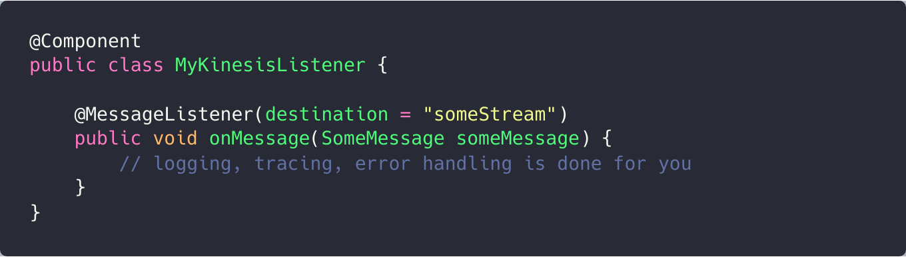
Step 3. Kinesis
Our (initial) Implementation

Slide 19
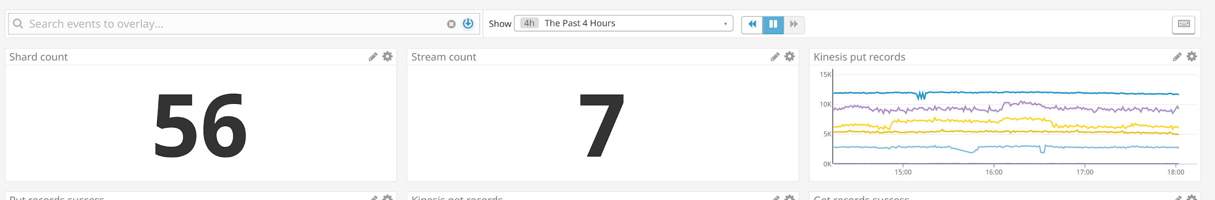
Step 3. Kinesis

Slide 20
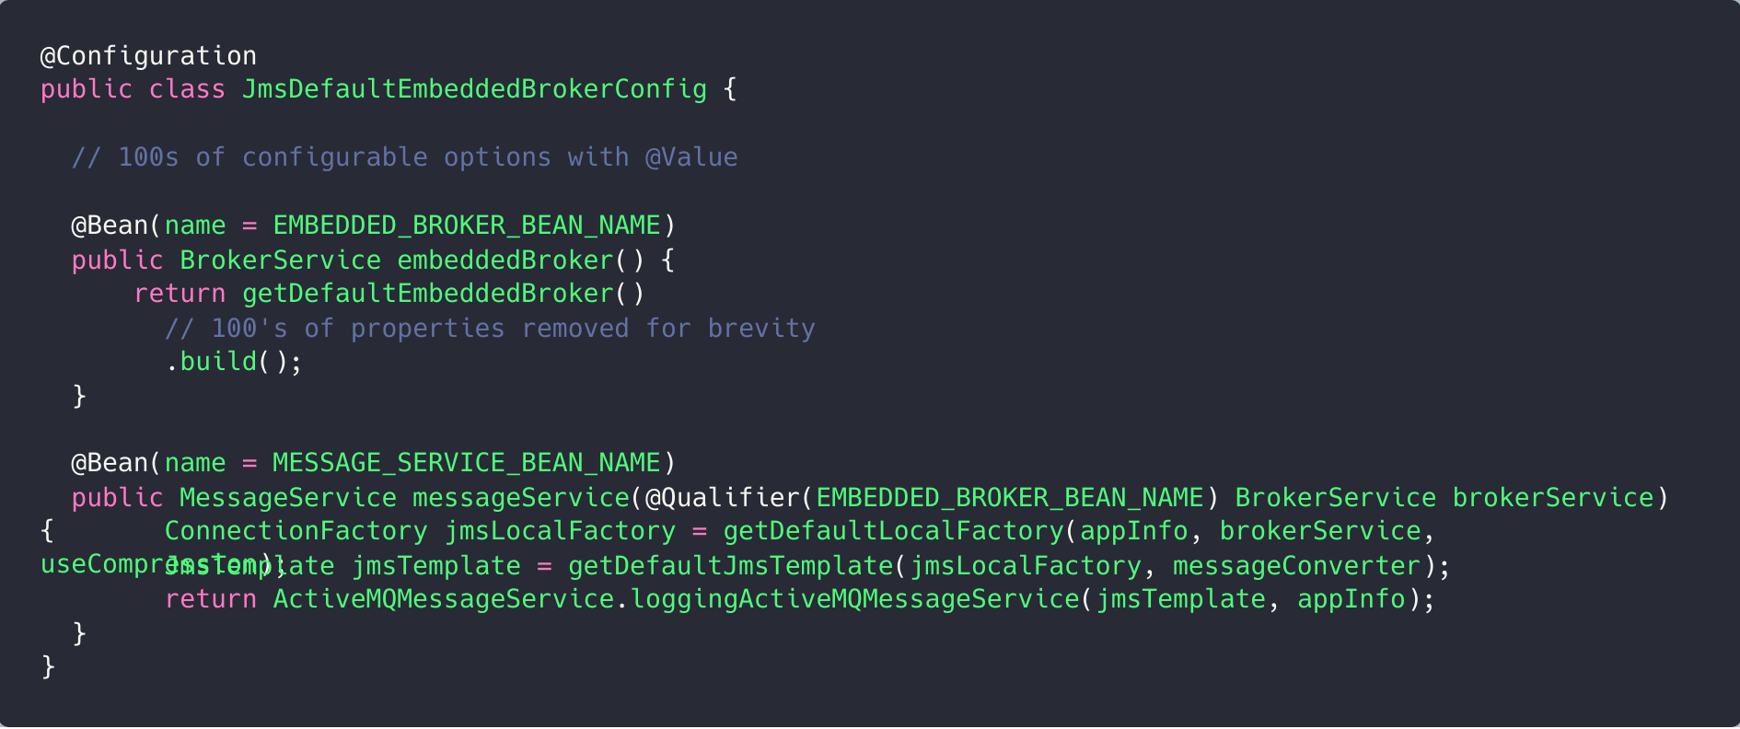
Step 4. Rich app library
Ready-made default contexts

Slide 21
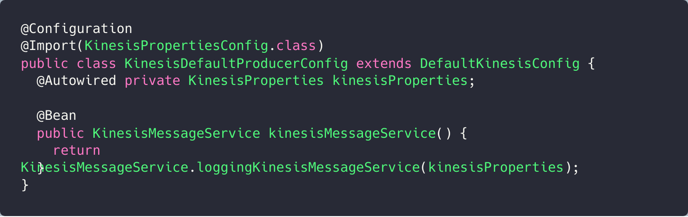
Step 4. Rich app library
And for Kinesis (sending)

Slide 22
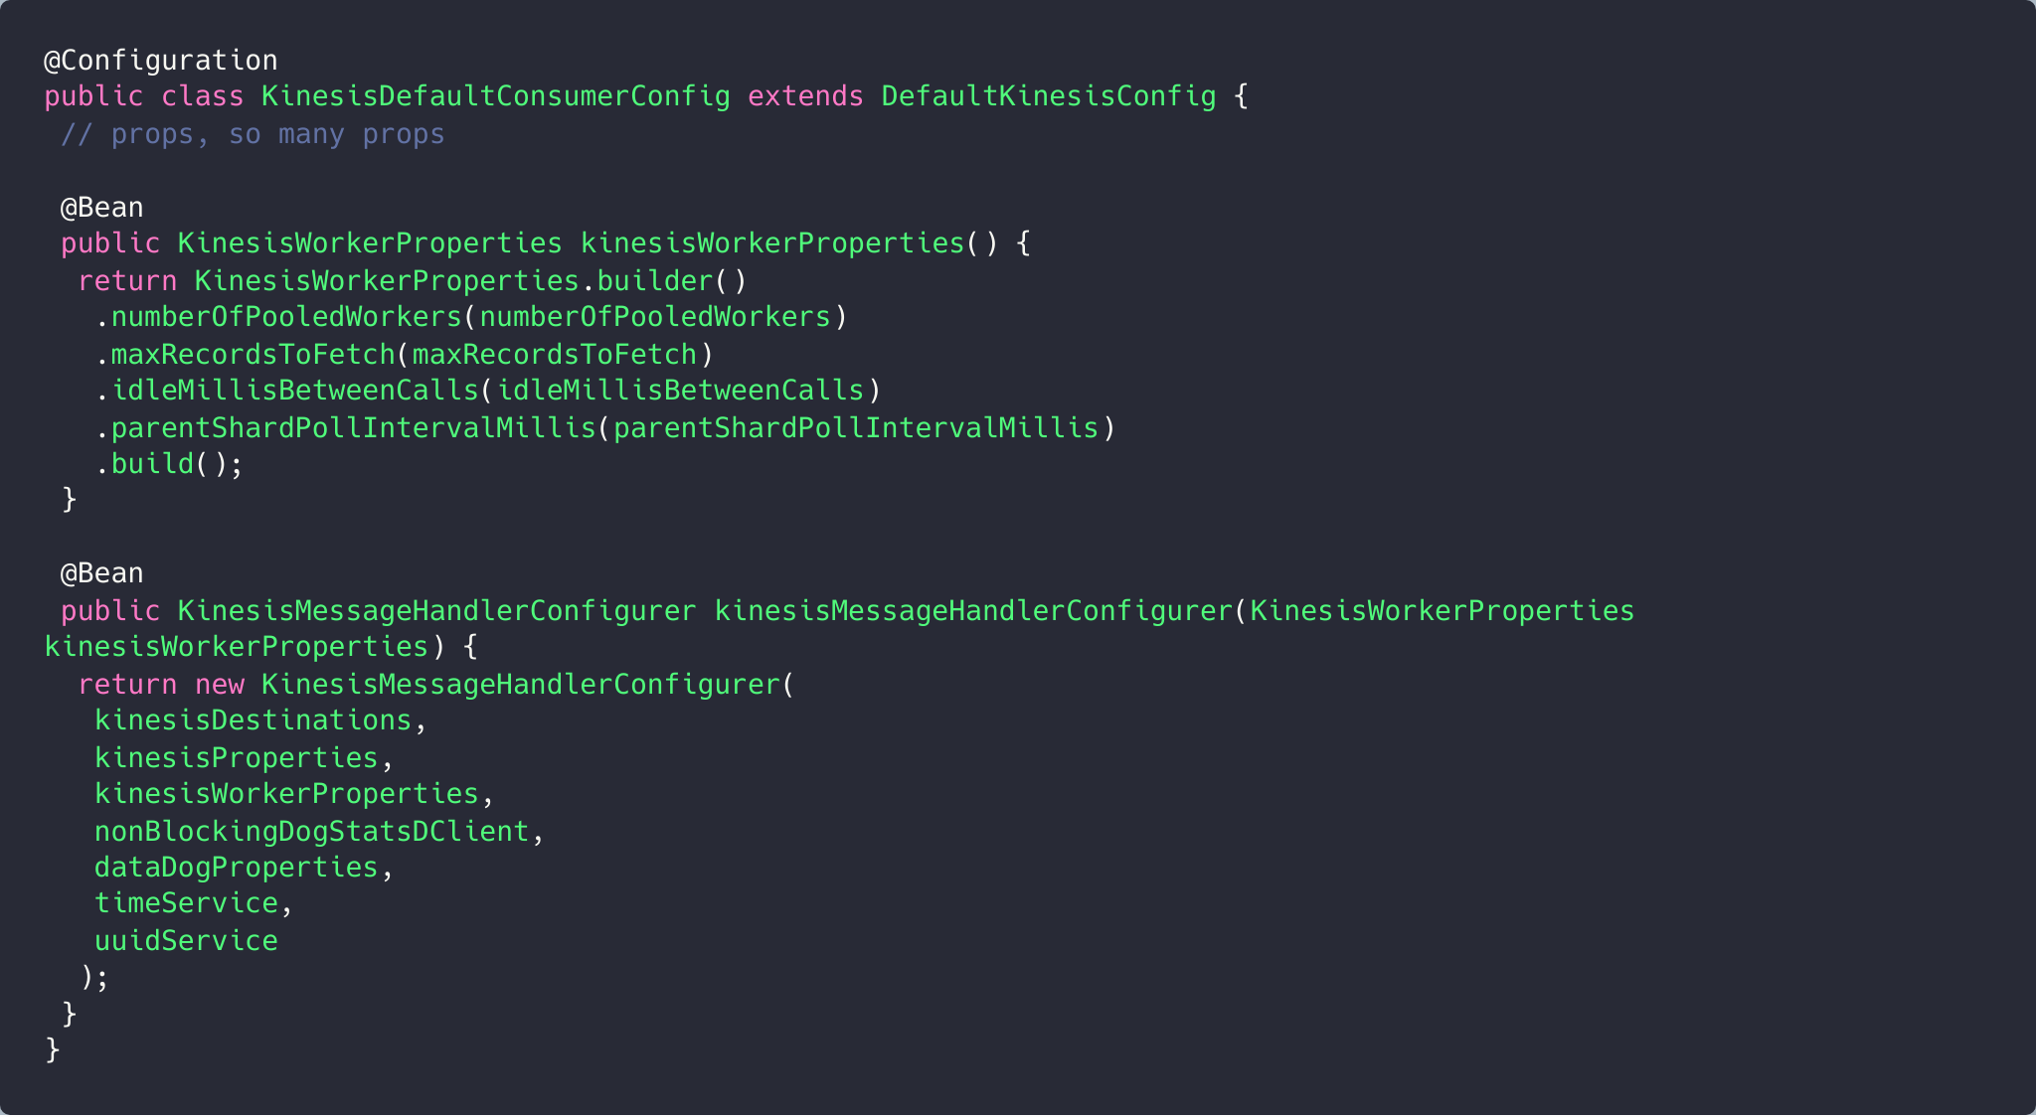
Step 4. Rich app library
And receiving

Slide 23
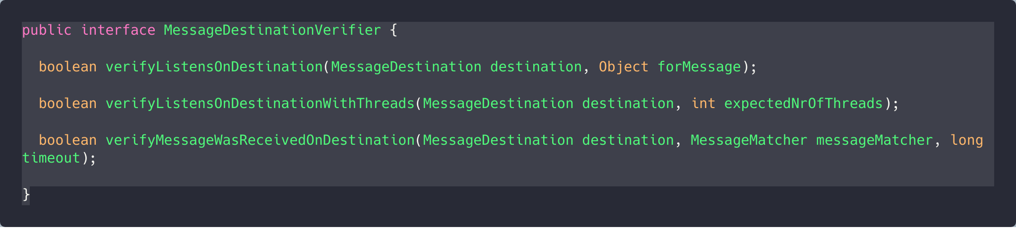
Step 4. Rich test library
Unit test verifiers

Slide 24
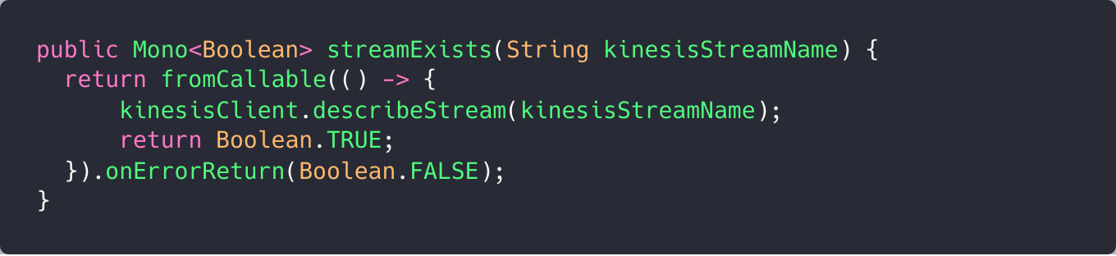
Step 4. Rich test library
Helpers for create/delete stream and associated resources

Slide 25
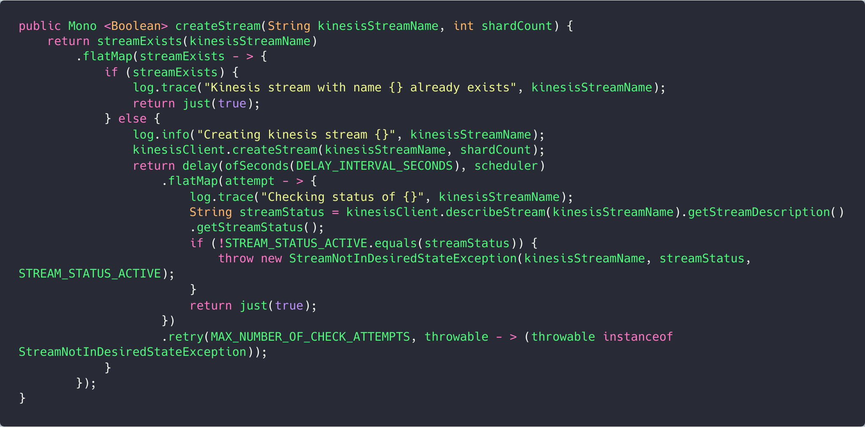
Step 4. Rich test library
Helpers for create/delete stream and associated resources

Slide 26
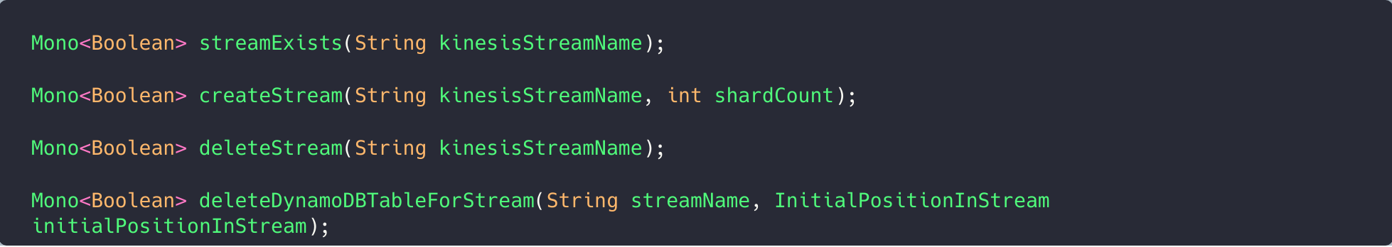
Step 4. Rich test library
Helpers for create/delete stream and associated resources

Slide 27

Making it Reactive

Slide 28

Reactive why?
Kinesis Spring Library does exist in Spring Cloud Kinesis (not reactive)
Spring reactive does exist (without Kinesis)
Kinesis Spring Library does exist in Spring Cloud Kinesis (not reactive)
Reactor does exist (without Kinesis)

Slide 29
Additionally...
Kinesis Spring Library does exist in Spring Cloud Kinesis (not reactive)
Spring reactive does exist (without Kinesis)
Backpressure
Message ordering
Duplicate detection
Retries
More efficient CPU usage

Slide 30
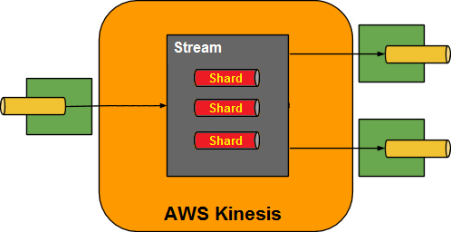
Message ordering
Kinesis Spring Library does exist in Spring Cloud Kinesis (not reactive)

Slide 31
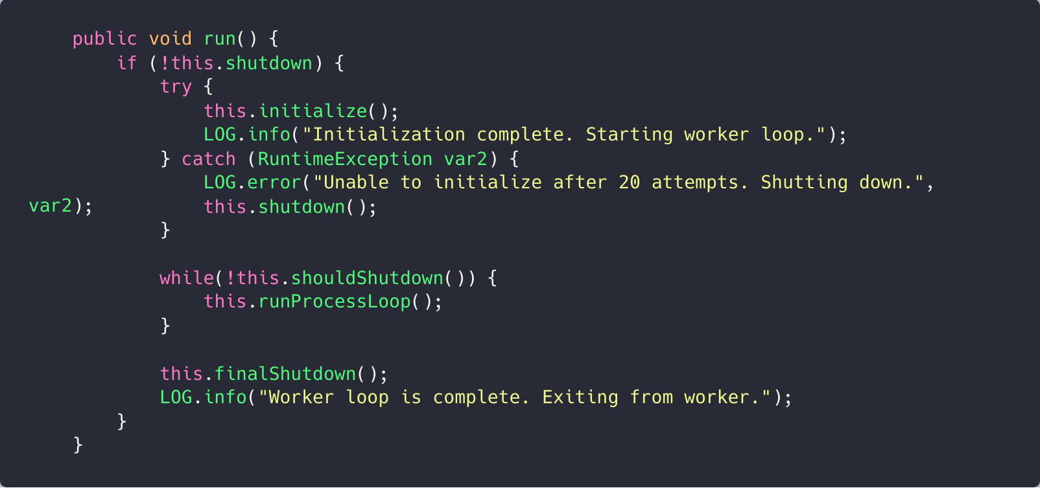
Message ordering
Kinesis Spring Library does exist in Spring Cloud Kinesis (not reactive)

Slide 32
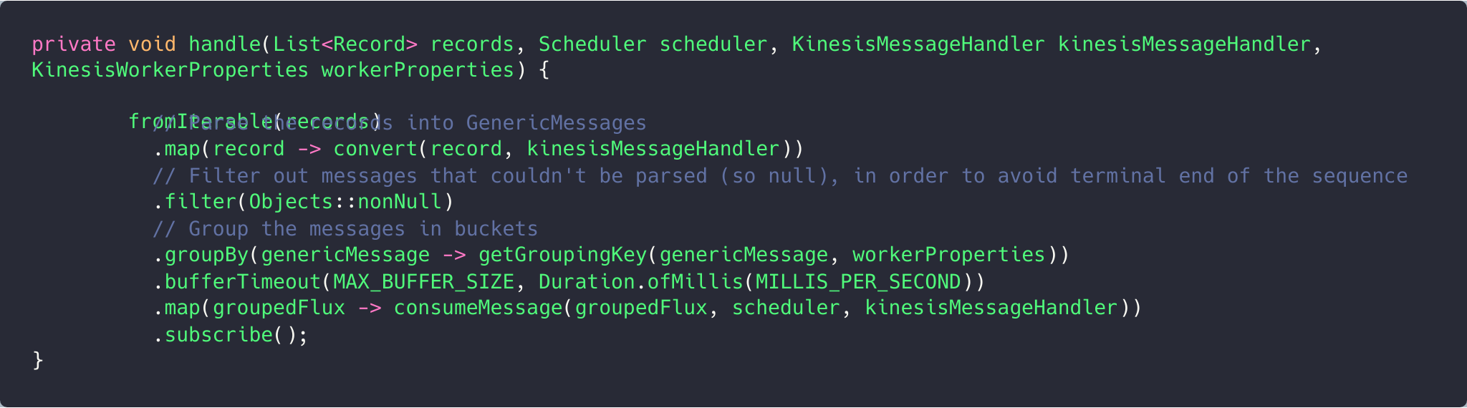
Message ordering + backpressure
Kinesis Spring Library does exist in Spring Cloud Kinesis (not reactive)

Slide 33
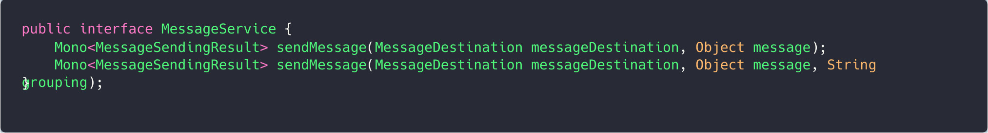
Backpressure on sending
Kinesis Spring Library does exist in Spring Cloud Kinesis (not reactive)

Slide 34
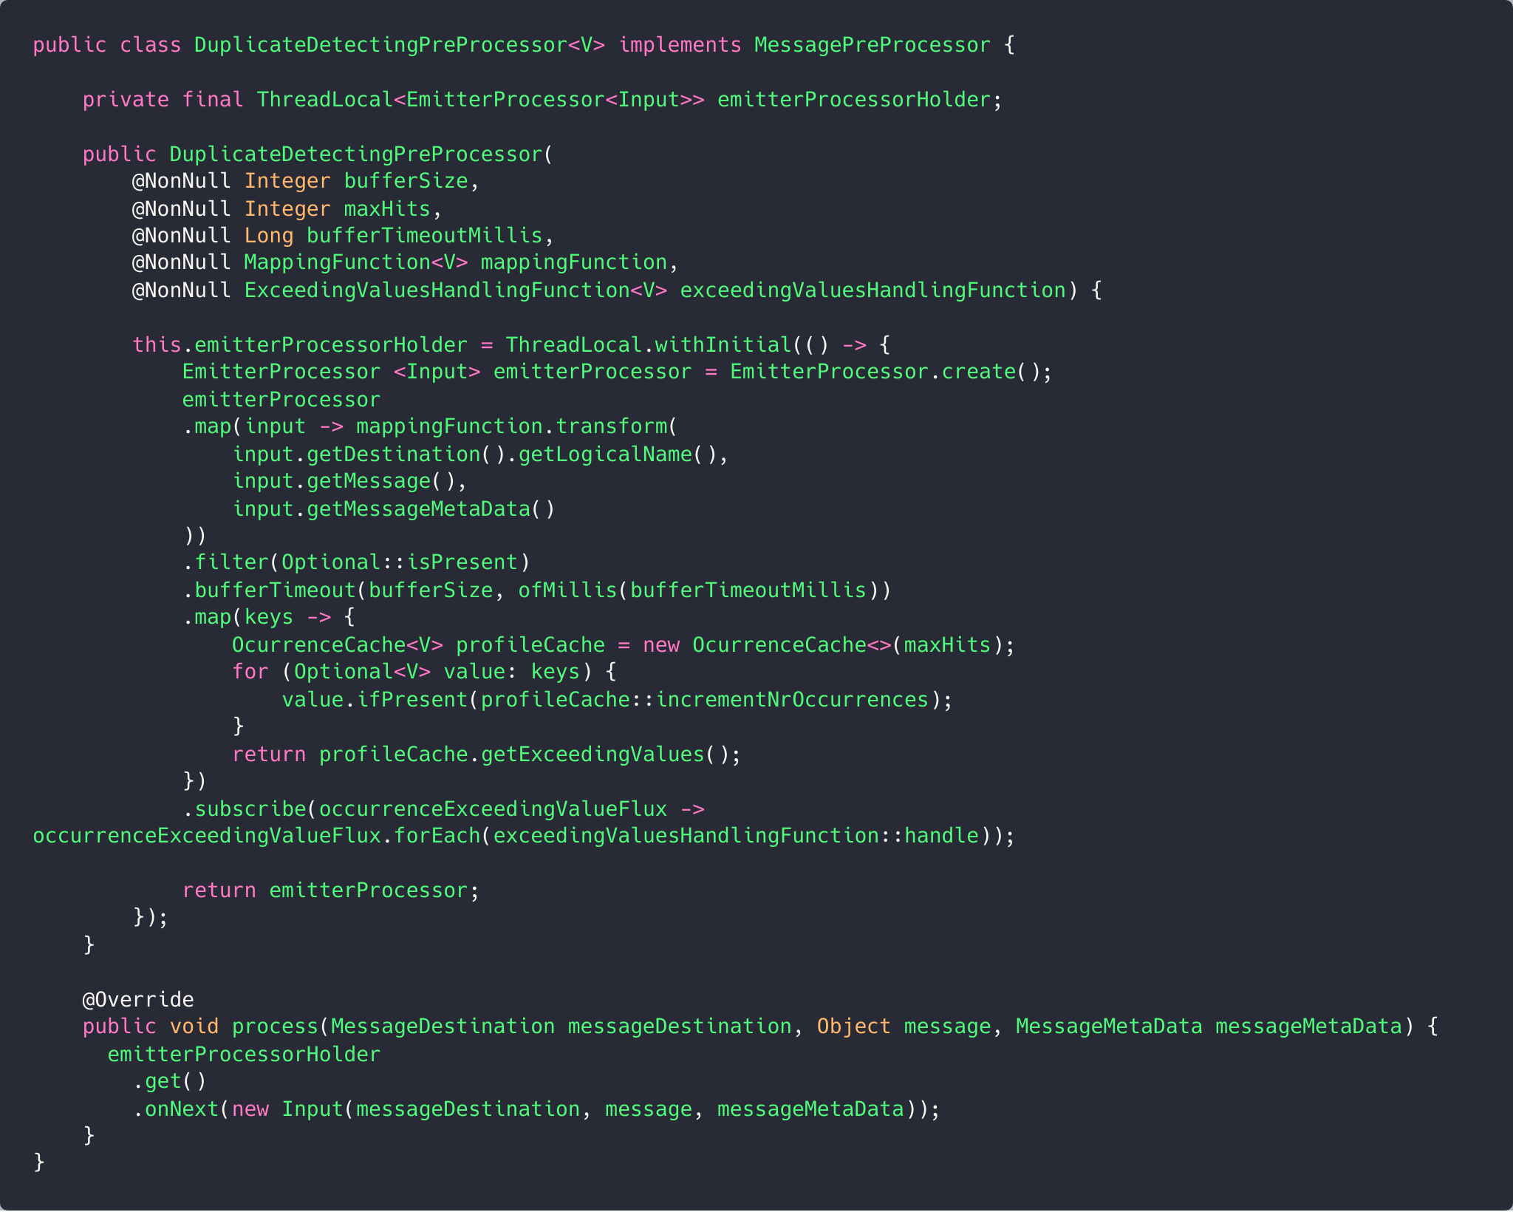
Duplicate detection
Kinesis Spring Library does exist in Spring Cloud Kinesis (not reactive)

Slide 35
Changing the contract
Kinesis Spring Library does exist in Spring Cloud Kinesis (not reactive)

Slide 36
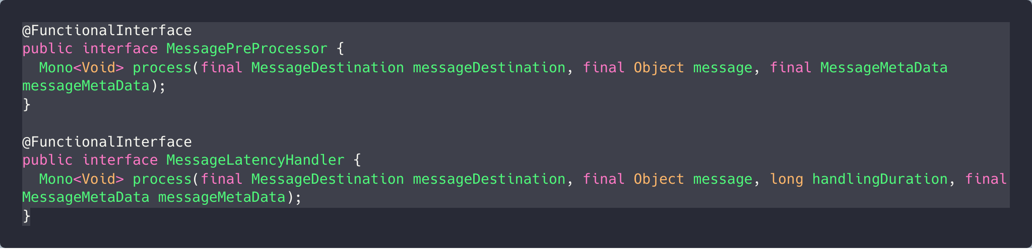
Changing the contract
Kinesis Spring Library does exist in Spring Cloud Kinesis (not reactive)

Slide 37

Future
Improvements

Slide 38
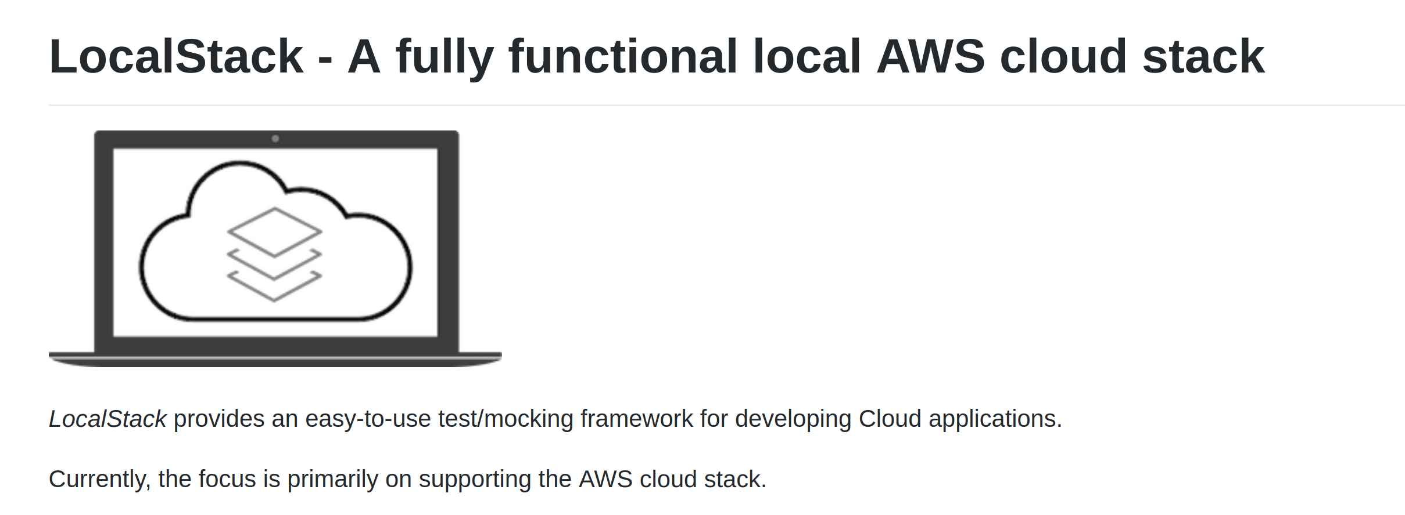
Localstack on integration tests
Cheaper
Faster
Cleaner

Slide 39
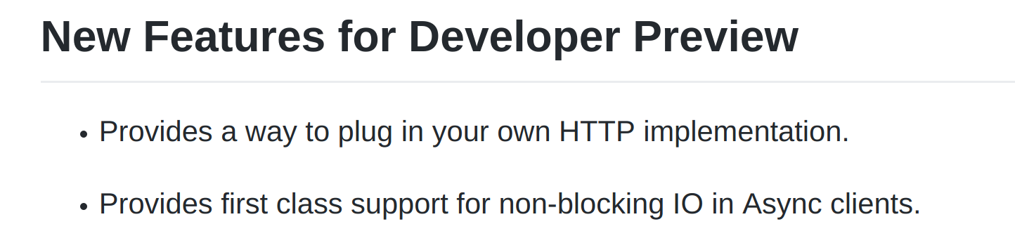
AWS SDK v2

Slide 40

Opensourcing

Slide 41
Questions?

